Slide 1

Part 3: Microsoft Powerpoint Presentation
OVERVIEW Of AKIJ FOOD AND BEVERAGE LTD.
Name : MD Sanaullah
Batch no : 039
Department : Biochemistry and Biotechnology
Date : 04/12/24

Slide 2
INTODUCTION TO AKIJ FOOD AND BEVERAGE LTD.
Akij Group was established in the 1950s by industrialist Sheikh Akijuddin as a cigarettes manufacturing business, before moving into other areas of business Like Rice, Jute, Paddy etc.
In 2009, Akij Group paid 390 million euros in tax, making it the biggest local tax-payer, contributing two per cent to the nation's entire budget.
Akij also provides services in healthcare, information and communication technology. Its turnover in 2009 was 89 billion taka.
In 2018, Akij sold their tobacco division to JTI for $1.47 billion. It was the biggest ever single foreign direct investment in Bangladesh.

Slide 3
Products
Akij FMCG Limited
Akij Bakers Limited.
Akij Island Limited
Akij Plastics Limited
Akij Buildtech Limited
Akij Cables Limited
Akij Electronics Limited
Ad-din Foundation
Ad-din Foundation

Slide 4
AKIJ FOOD AND BEVERAGE LTD statistical analysis
Key Performance Indicators
Revenue Growth: Showing consistent growth quarter over quarter.
Cost of Goods Sold (COGS): Maintained in line with revenue, indicating good cost management.
Units Sold: Fluctuating slightly but overall showing an upward trend.
Financial Highlights
Q1 2024 & Q1 2017 had the highest revenue at $102,000,000.
Q2 2025 had the lowest revenue at $66,000,000.
Profit Margin is stable around 50%.

Slide 5
Total sales till now
Region | Total Sales (BDT)
Barishal | 5010000
Chittagong | 4340000
Khulna | 4110000
Rajshahi | 4760000
Sylhet | 4600000
Dhaka | 5850000

Slide 6
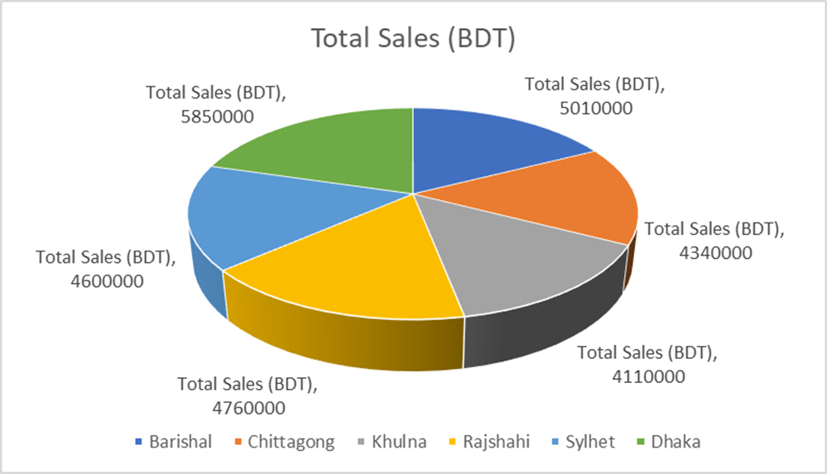
AKIJ FOOD AND BEVERAGE LTD statistical analysis

Slide 7
Conclusion
Sales Strategy
Focus on expanding sales in Q3 and Q4 to maximize revenue.
Consider promotional campaigns to boost sales during slower quarters.
Cost Management
COGS is consistently around 50% of revenue, indicating good cost control.
Monitor COGS closely to ensure profitability.
Future Outlook
Consistent revenue growth suggests a positive outlook.
Explore opportunities for product diversification and market expansion.

Slide 8
Visit : akij-food-beverage-ltd for more details
Contact : 01755*****5

